Slide 1
Needfinding in the realm of music experiences
Elsie, Alix, Jialin, Constance

Slide 2
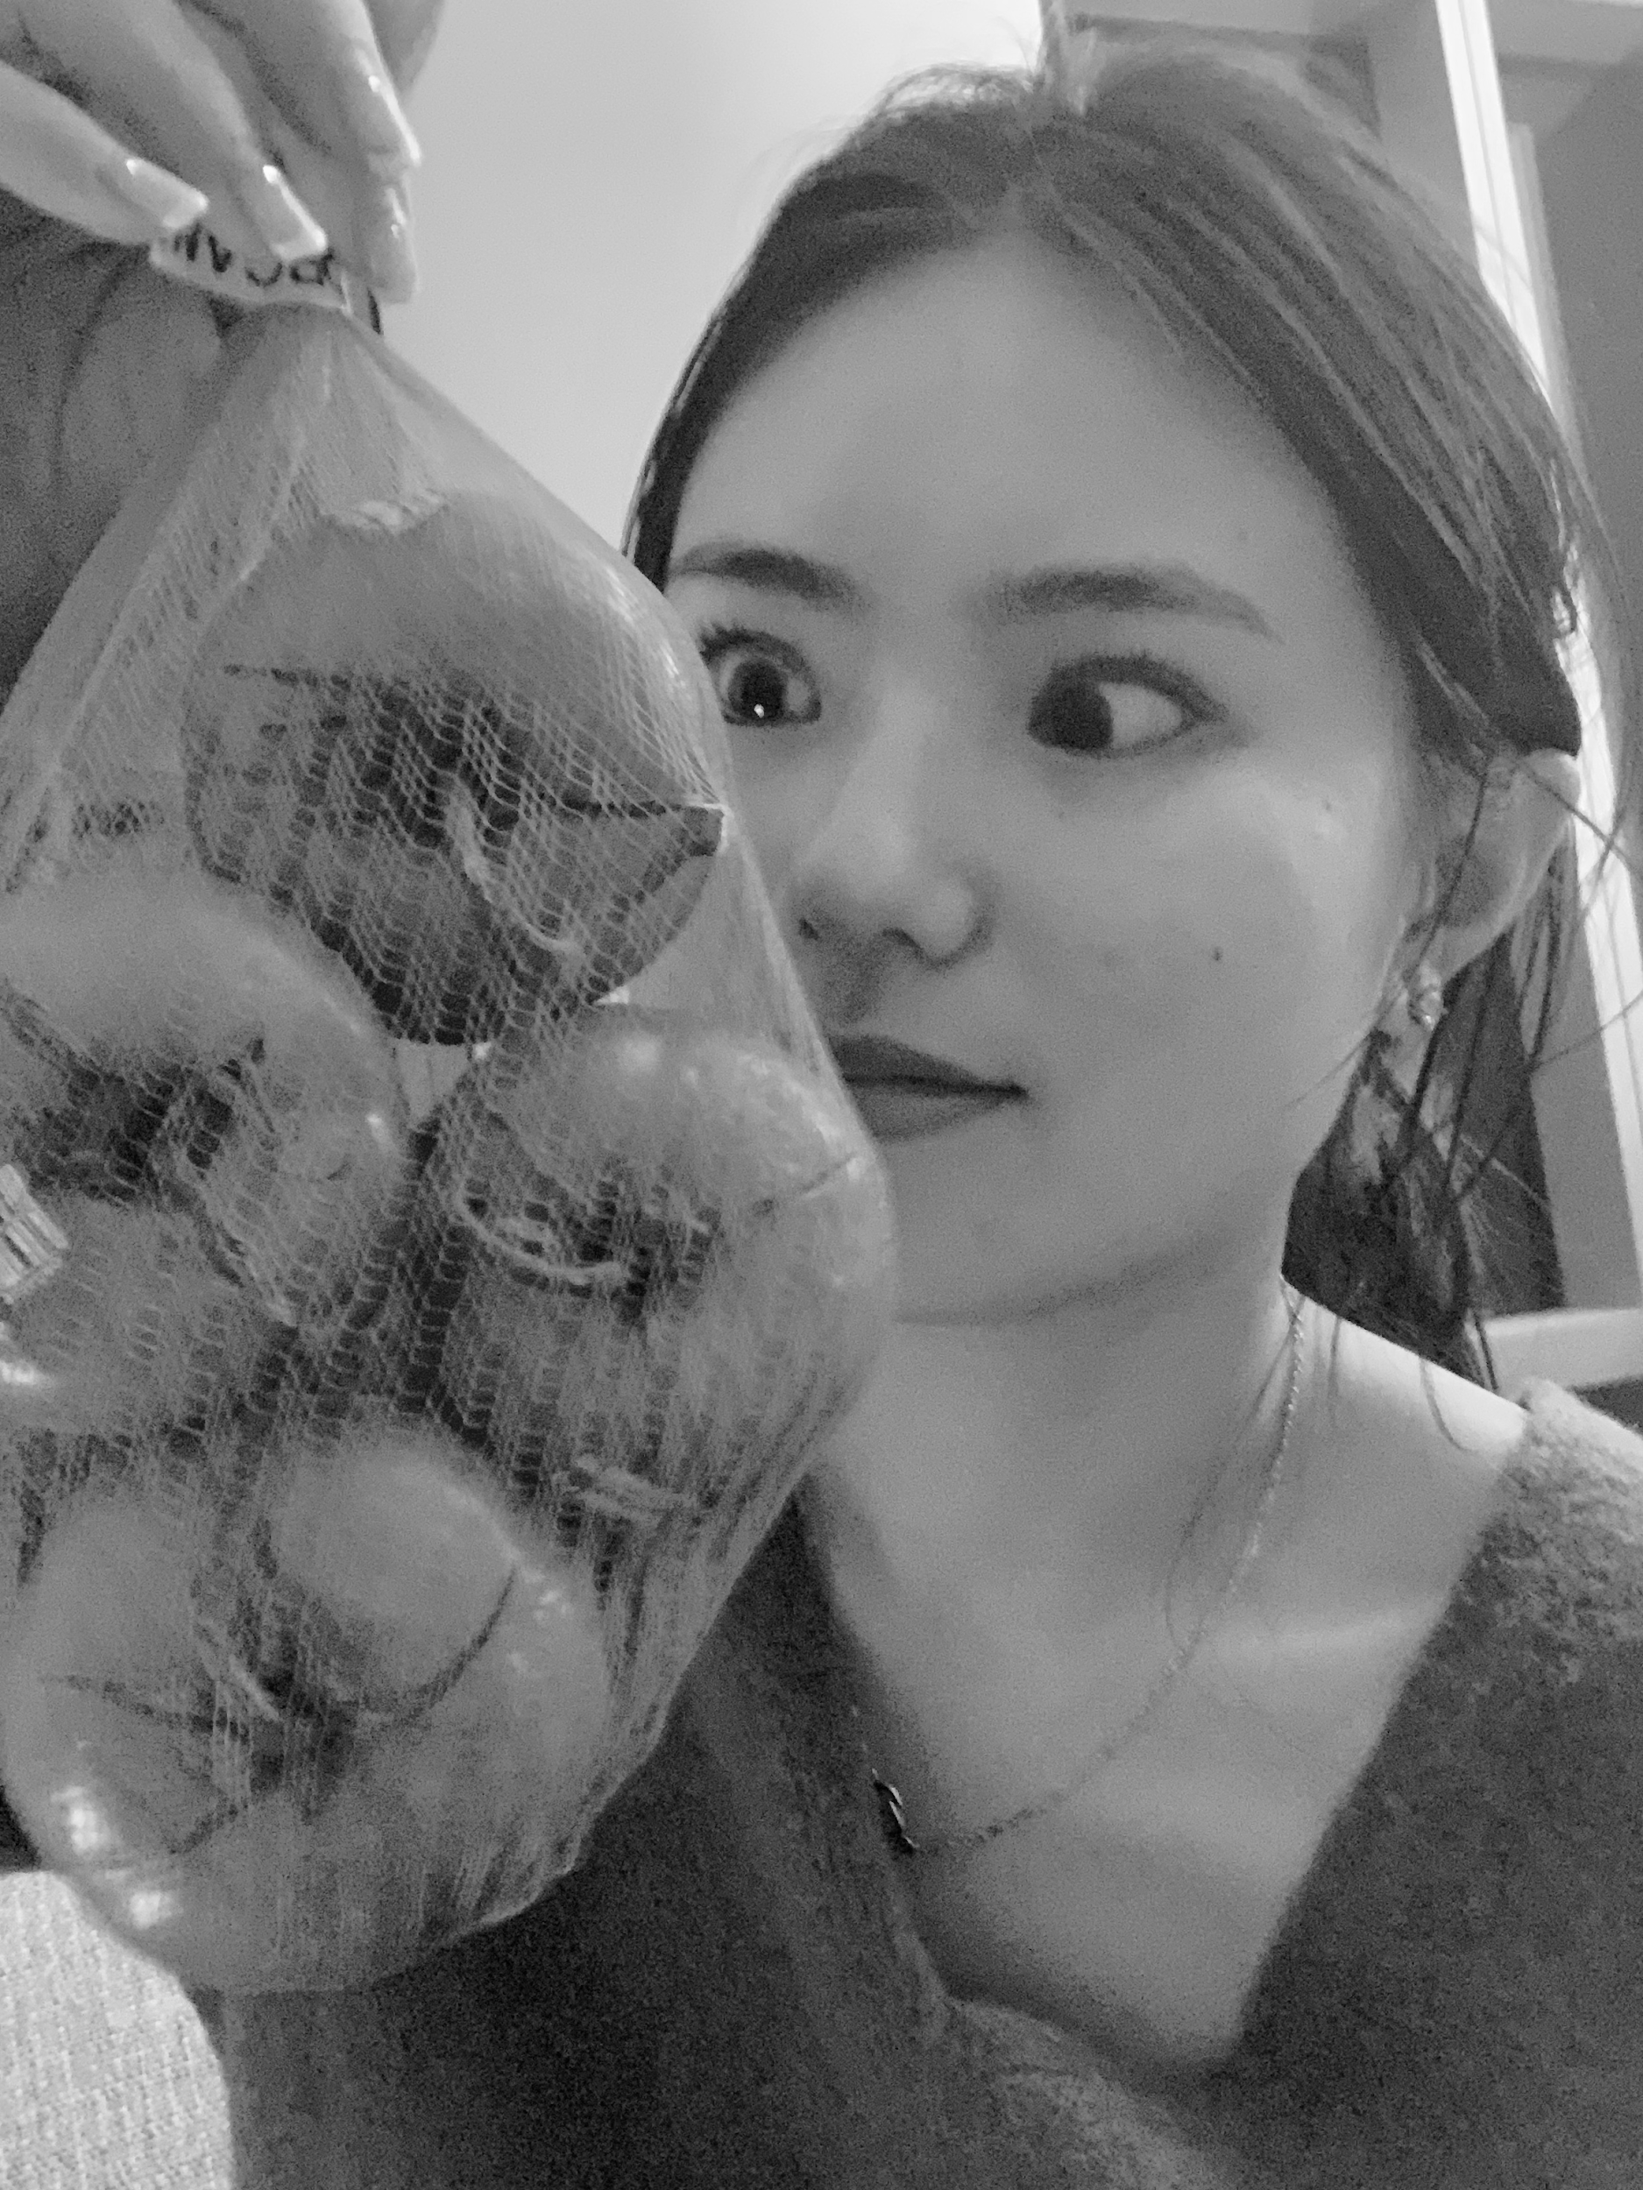
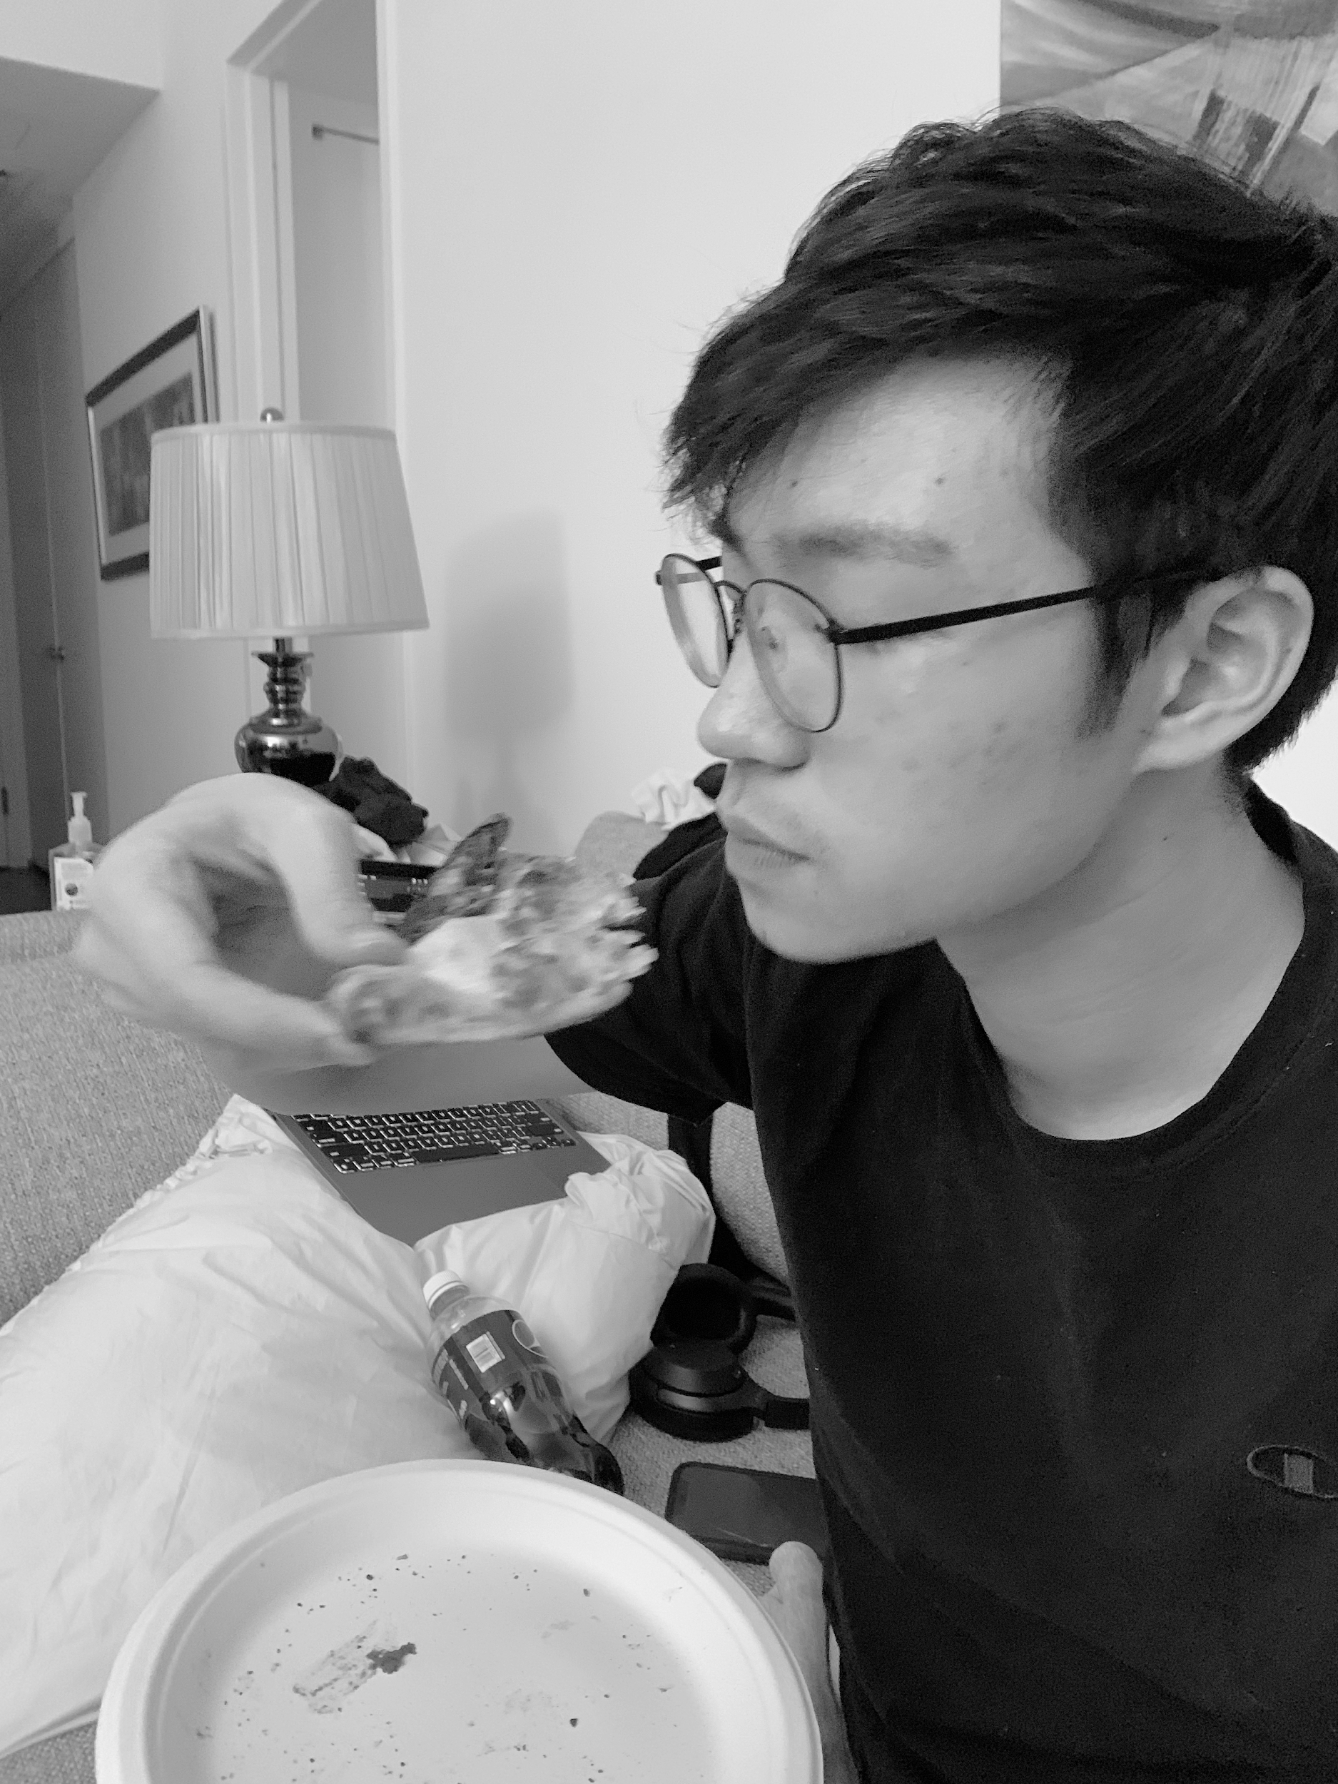
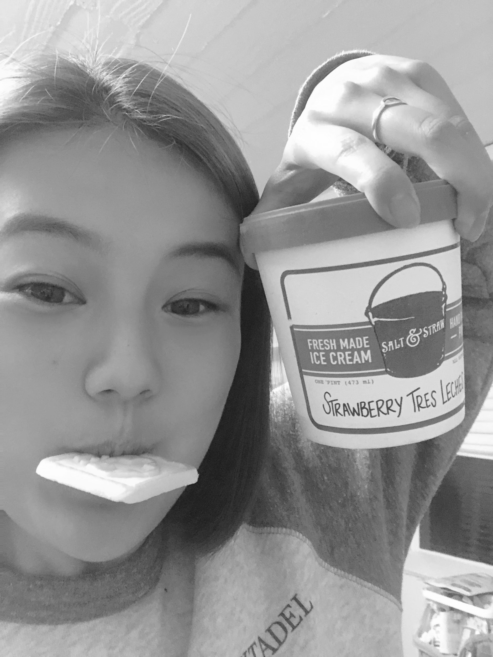
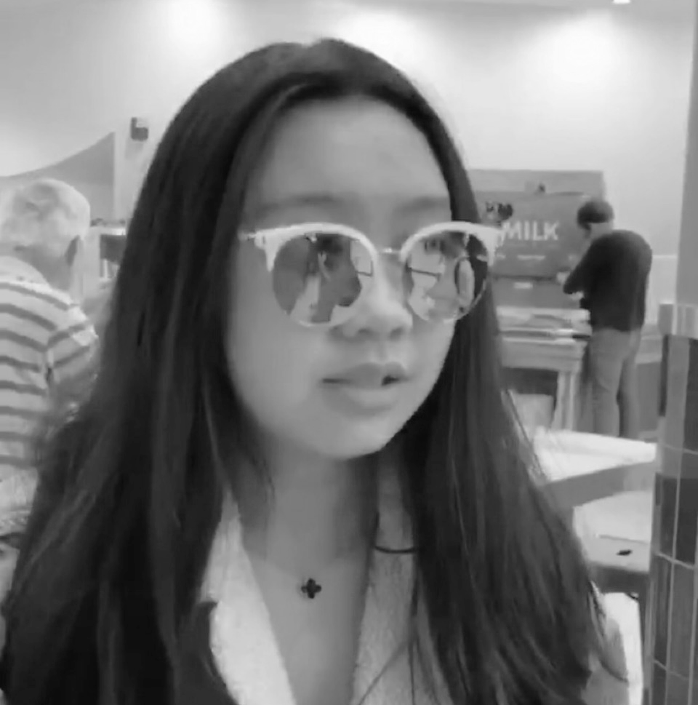
Hello from the team that loves food & music 👋
Elsie
SymSys
Alix
Computer Science
Jialin
Computer Science
Constance Computer Science
Currently listening to...
bloody valentine
MGK
Save Your Tears
The Weeknd
drivers license
Olivia Rodrigo
Psycho
Post Malone

Slide 3

Art & Culture
Music Discovery & Creativity

Slide 4
NEEDFINDING METHODOLOGY asking the right questions

Slide 5
What empowers creators?
What do people value most about the music experience?
help creators execute on their creativity and enable people to discover content which they resonate with
Notes:
Inspired by the studio description, we came up with a few design questions for both creators...

Slide 6
How do people discover music?
help creators execute on their creativity and enable people to discover content which they resonate with
What do people value most about the music experience?
Notes:
...and consumers.

Slide 7
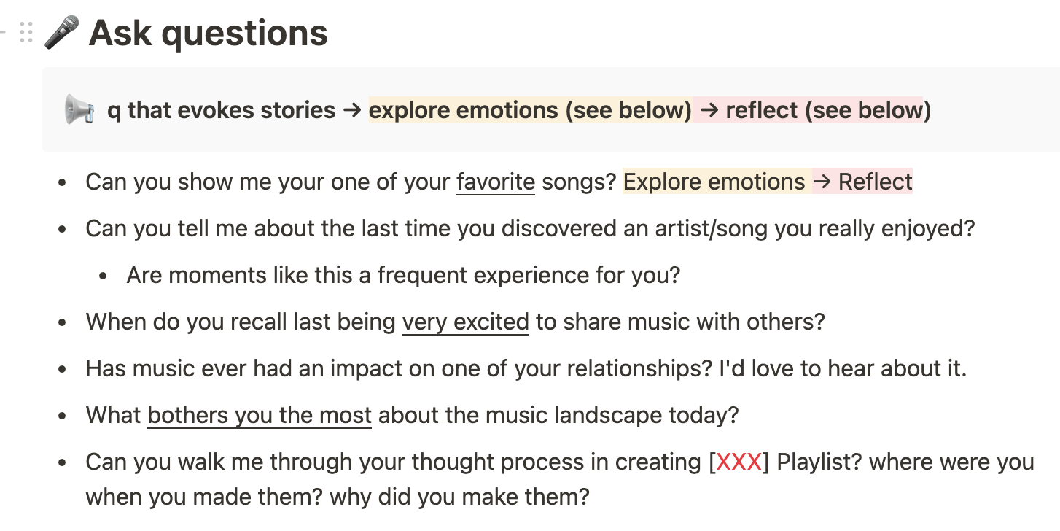
We came up with 3 motivating design questions and created a repo of discussion prompts from them.
1
What do people value most about the music experience?
2
How do people discover music?
3
What empowers creators?
Full interview guides in Google folder (incl. questions for creators)

Slide 8
Our prompts were designed to evoke stories
Explore emotions
Evoke stories
Tell me about the last time you discovered a song you liked.
Reflect
Build rapport
Wrap-up
Intro project
Intro yourself

Slide 9
If we noticed a thread come out from one of them, we’d start pulling it...
Explore emotions
Why is this your favorite?
How did you feel in that moment of discovery?
Evoke stories
Reflect
Build rapport
Wrap-up
Intro project
Intro yourself

Slide 10
...and ask interviewees to unpack contradictions and reactions as we notice them
Explore emotions
Evoke stories
Reflect
You say this is your fav song...why do you grimace when talking about it?
Build rapport
Wrap-up
Intro project
Intro yourself

Slide 11
NEEDFINDING METHODOLOGY talking to the right people

Slide 12
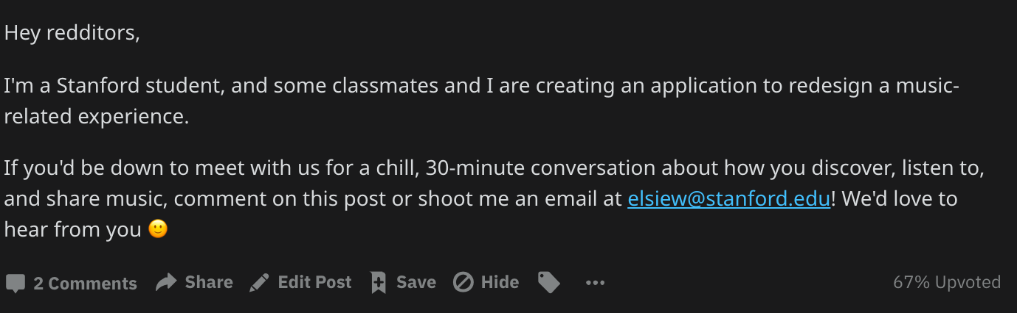
We posted to reddit forums r/CasualConversation and r/FutureBeats and looked to first & second-degree connections...

Slide 13
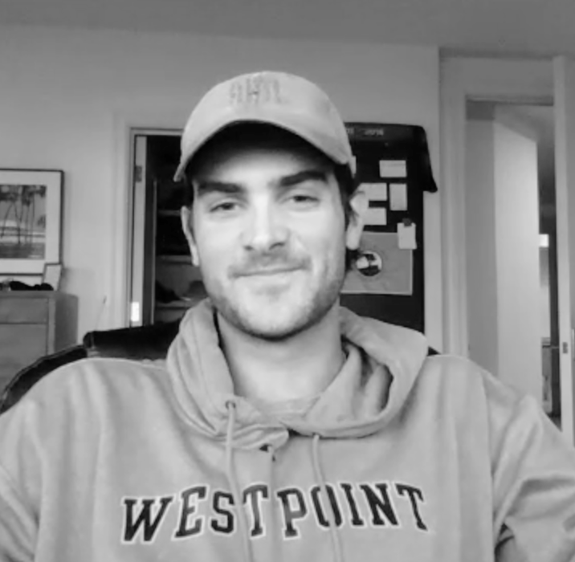
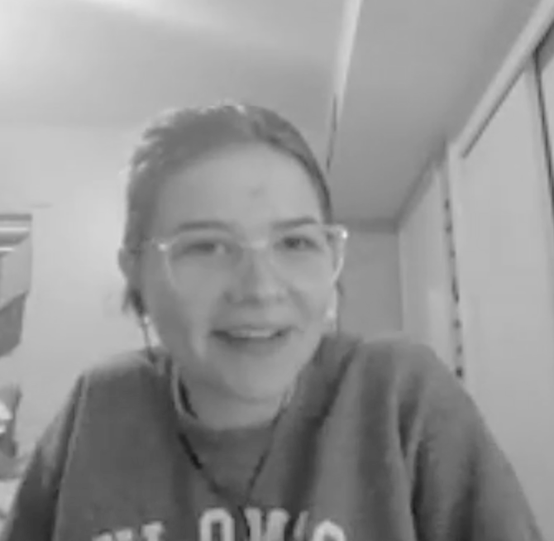

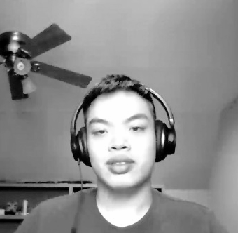
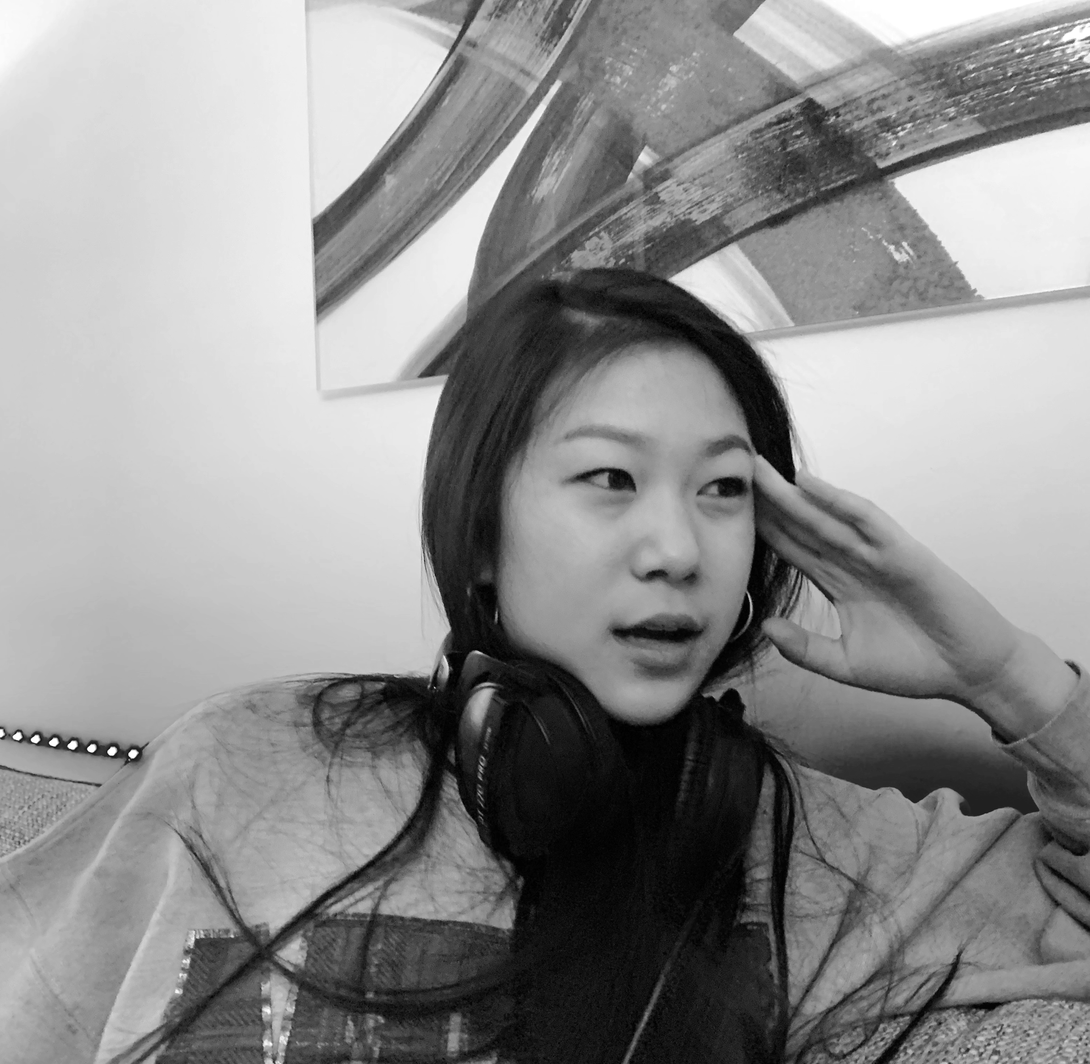
We talked to 5 people… (no compensation)
Max
Senior @ Stanford, MS&E Major
(work colleague)
Veronica
Soph @ UNO, Polisci Major
(high school friend)
Corey
Part-time teacher, fresh grad
(r/FutureBeats)
Thi
Senior @ UH, part-time NASA SWE, amateur guitarist
(r/CasualConversation)
Gloria
Soph @ Columbia, Music Major, producer
(musician friend)

Slide 14
...including 2 extreme users
Freelancer on fiverr, makes new music every week
Max
Senior @ Stanford, MS&E Major
Veronica
Soph @ UNO, Polisci Major
Corey
Part-time teacher, fresh grad
Thi
Senior @ UH, part-time NASA SWE, amateur guitarist
Gloria
Soph @ Columbia, Music Major, producer
super-listener
music as career
Saved 6000+ songs on spotify, made 75+ playlists

Slide 15


Though we recognize that we need to seek more diversity in our conversations
4 / 5 participants were college students
In the future, we hope to talk to more pre-college and post-college people as well as typical music consumers
4 / 5 participants were either on the creator spectrum or is a super-listener

Slide 16
interview results

Slide 17
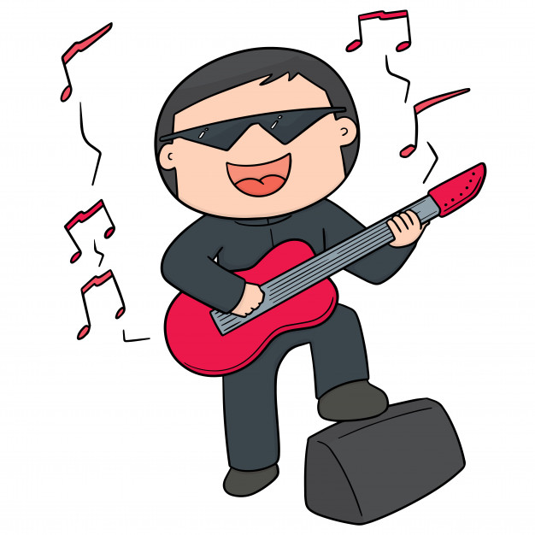
“My first love was hip-hop because it was so collaborative.”
Corey
Substitute teacher & music history buff who dabbles in creation

Slide 18
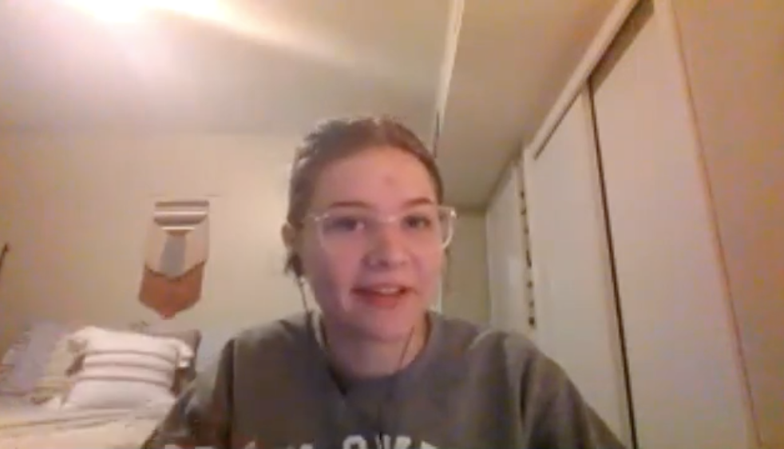
“We made this album for songs that remind us of the memories we had.”
Veronica
Your typical casual listener

Slide 19
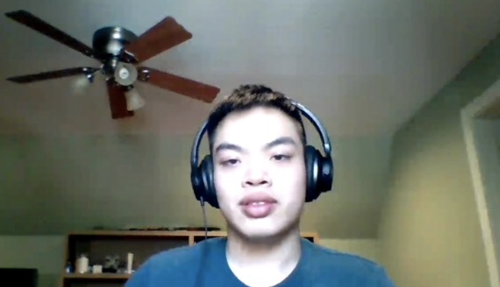
“Creating music gives a sense of accomplishment.”
Thi
Engineer who loves playing guitar for his girl friend

Slide 20
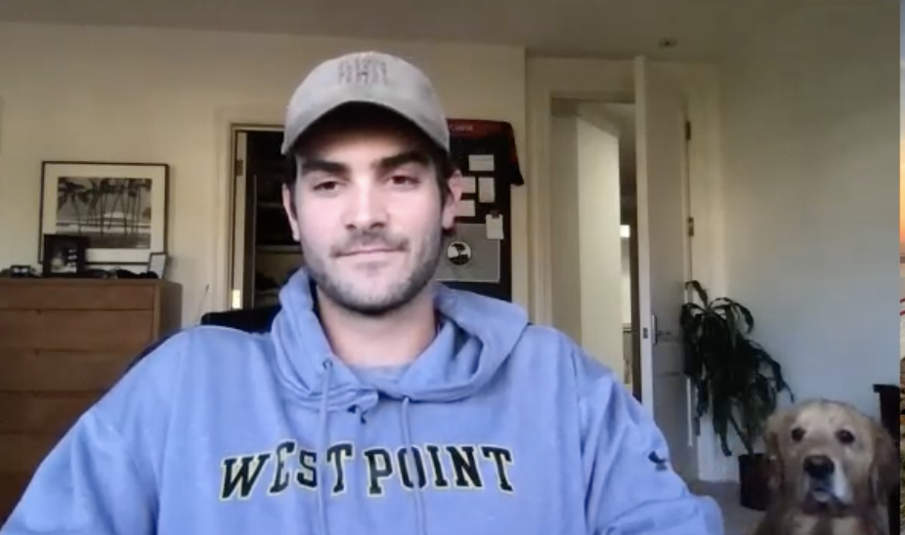
“Sharing music has become a core tenet of my friendships.”
Max
College student and avid music connoisseur
doggy!

Slide 21
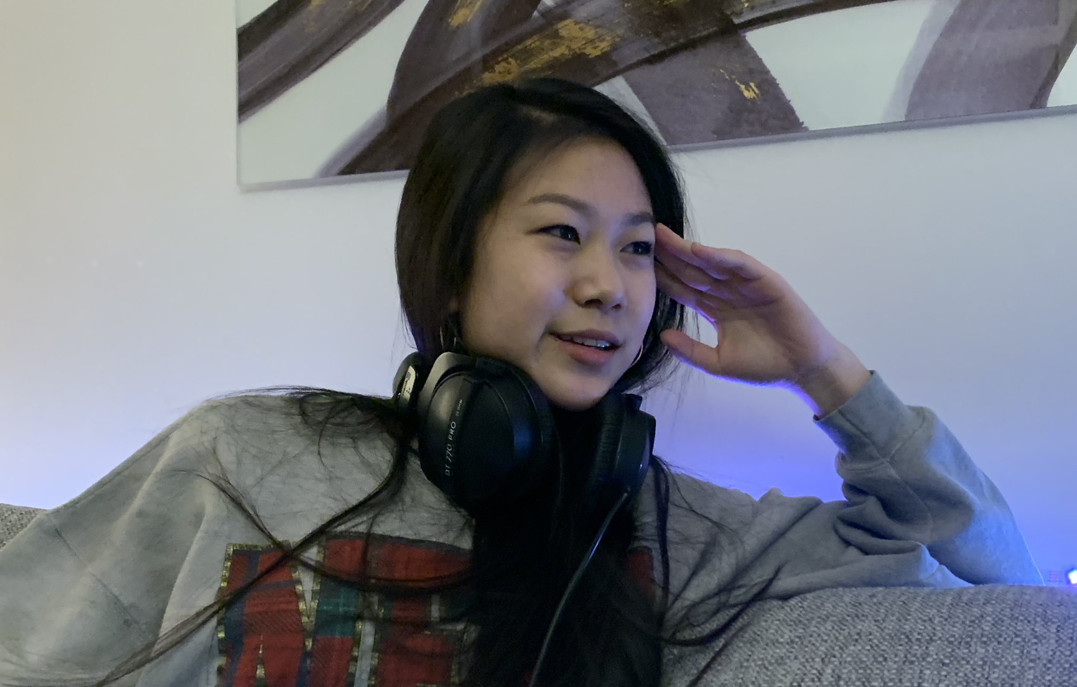
“This is my favorite project because I have full creative control.”
Gloria
Freelance producer and music major

Slide 22
ANALYSIS
surprises, tensions, & contradictions

Slide 23
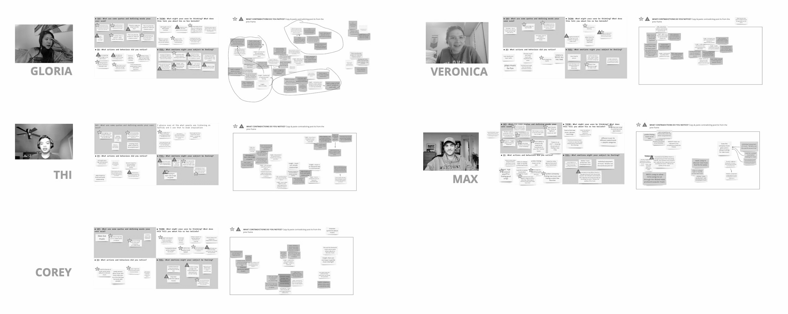
Individual empathy maps and analyses
PDF version in team drive. Link to maps.

Slide 24
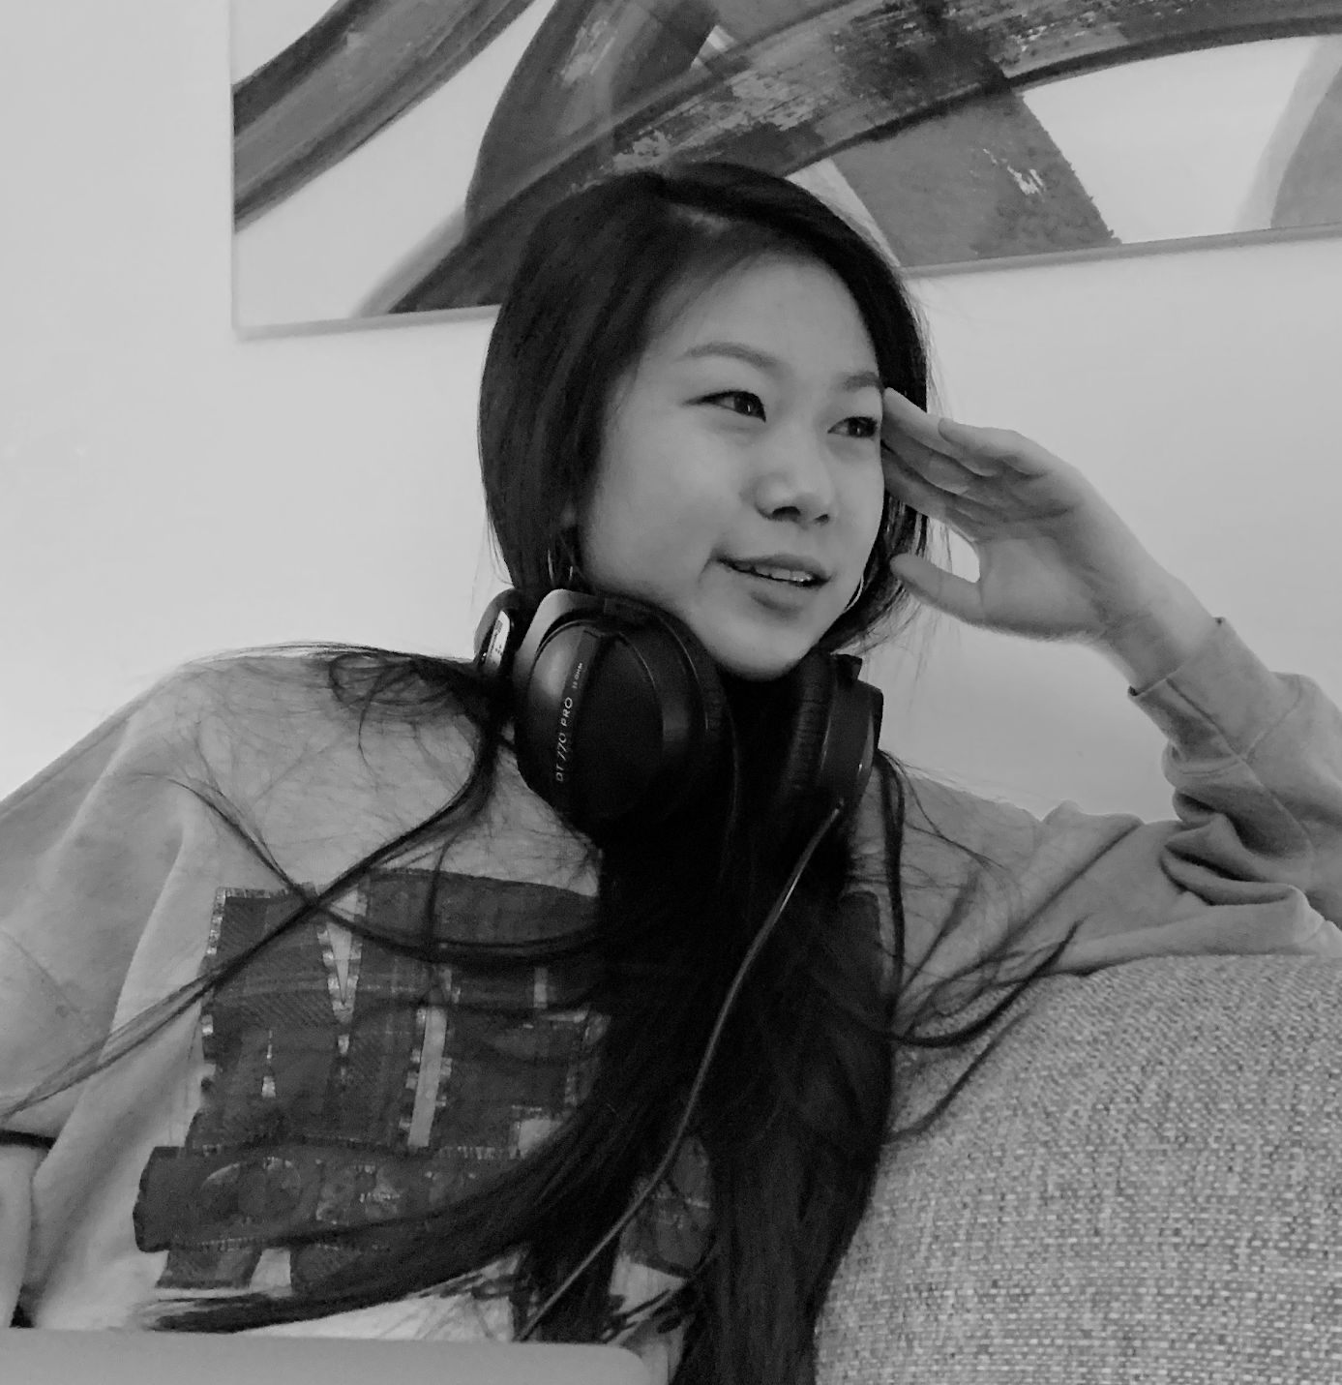
For today’s presentation, we’ll zoom in one one of our most insightful convos.
Gloria (90min interview)
Freelance producer, music major

Slide 25

"Sometimes I just wanna record a cover for myself and film a silly mv with my friends”
“[...] is my favorite project because I have full control over it.”
"It's better to record a song + mv than taking a pic to capture a moment into memory.”
“Music is a social medium – a great way to meet new artists.”
SAY
Creates playlists based on colors
Freelances on fiverr where client is always right
Became super animated when speaking about improv & creative expression
Mostly listens to songs that could inspire her in the right direction (for her client)
DO

Slide 26
How can I bring my music to the next level?
Collaborating with artists is complicated and tedious
Offering cheap services as a freelancer is a necessary “evil”
Sending drafts to other musicians is an important way to stay inspired and get feedback
THINK
Trapped in a male-dominated industry
Extremely anxious during back-and-forth with clients
Frustrated when freelancing with bad clients
Unwilling to show her work to others before final draft; doesn’t want to disturb others and is insecure
FEEL

Slide 27


"Sometimes I just wanna record a cover for myself and film a silly mv with my friends”
“[...] is my favorite project because I have full control over it.”
"It's better to record a song + mv than taking a pic to capture a moment into memory.”
“Music is a social medium – a great way to meet new artists.”
SAY
surprise
Creates playlists based on colors
Freelances on fiverr where client is always right
Became super animated when speaking about improv & creative expression
Mostly listens to songs that could inspire her in the right direction (for her client)
DO

Slide 28
"Sometimes I just wanna record a cover for myself and film a silly mv with my friends”
“[...] is my favorite project because I have full control over it.”
"It's better to record a song + mv than taking a pic to capture a moment into memory.”
“Music is a social medium – a great way to meet new artists.”
SAY
surprise
Creates playlists based on colors
Freelances on fiverr where client is always right
Became super animated when speaking about improv & creative expression
Mostly listens to songs that could inspire her in the right direction (for her client)
DO

Slide 29
INSIGHT
Listening to music is an emotional experience, so tying music to a memory makes it more vivid and magical.
NEED
It would be transformative to enable people to seamlessly extract and inject music from/into memories

Slide 30
"Sometimes I just wanna record a cover for myself and film a silly mv with my friends”
“[...] is my favorite project because I have full control over it.”
"It's better to record a song + mv than taking a pic to capture a moment into memory.”
“Music is a social medium – a great way to meet new artists.”
SAY
contradiction
How can I bring my music to the next level?
Collaborating with artists is complicated and tedious
Offering cheap services as a freelancer is a necessary “evil”
Sending drafts to other musicians is an important way to stay inspired and get feedback
THINK

Slide 31
INSIGHT
She wants to work with other people, but doesn’t want to go through the stress of reaching out and coordinating.
NEED
It would be transformative to remove barriers for reach-outs and simplify communication mechanisms between musicians.

Slide 32
"Sometimes I just wanna record a cover for myself and film a silly mv with my friends”
“[...] is my favorite project because I have full control over it.”
"It's better to record a song + mv than taking a pic to capture a moment into memory.”
“Music is a social medium – a great way to meet new artists.”
SAY
contradiction
Creates playlists based on colors
Freelances on fiverr where client is always right
Became super animated when speaking about improv & creative expression
Mostly listens to songs that could inspire her in the right direction (for her client)
DO

Slide 33
"Sometimes I just wanna record a cover for myself and film a silly mv with my friends”
“[...] is my favorite project because I have full control over it.”
"It's better to record a song + mv than taking a pic to capture a moment into memory.”
“Music is a social medium – a great way to meet new artists.”
SAY
contradiction
Creates playlists based on colors
Freelances on fiverr where client is always right
Became super animated when speaking about improv & creative expression
Mostly listens to songs that could inspire her in the right direction (for her client)
DO

Slide 34
INSIGHT
The way client work in music freelancing is done currently restricts her from exploring creatively, a process she values a lot.

Slide 35

How can I bring my music to the next level?
Collaborating with artists is complicated and tedious
Offering cheap services as a freelancer is a necessary “evil”
Sending drafts to other musicians is an important way to stay inspired and get feedback
THINK
major tension!
Trapped in a male-dominated industry
Extremely anxious during back-and-forth with clients
Frustrated when freelancing with bad clients
Unwilling to show her work to others before final draft; doesn’t want to disturb others and is insecure
FEEL

Slide 36
INSIGHT
Musicians who are just starting out feel they have no choice but to sacrifice their comfort and creative control to get their name on the map and maintain a steady income

Slide 37
INSIGHT
INSIGHT
music freelancing restricts her from exploring creatively
no choice but to freelance, sacrificing comfort and creative control
NEED
It would be revolutionary to redesign the work model; deconstruct the transactional element of freelancing and the notion that client is king

Slide 38
How can I bring my music to the next level?
Collaborating with artists is complicated and tedious
Offering cheap services as a freelancer is a necessary “evil”
Sending drafts to other musicians is an important way to stay inspired and get feedback
THINK
contradiction
Trapped in a male-dominated industry
Extremely anxious during back-and-forth with clients
Frustrated when freelancing with bad clients
Unwilling to show her work to others before final draft; doesn’t want to disturb others and is insecure
FEEL

Slide 39
INSIGHT
Her insecurities and the favor-soliciting nature of asking for critique hinder her from asking for feedback, which is critical to creating better music.
NEED
It was be game-changing to create an ambiguity-free, ego-free, frictionless system in which creators can receive feedback on their works-in-progress.

Slide 40
Zooming out, our other conversations also revealed common insights and needs...
use music to maintain and build relationships
Love discovering new music, but unwilling to invest additional time + energy to search
Frustrated with popular songs drowning out smaller artists and diluting music quality.
INSIGHT
Music is a form of communication that can heal relationships
NEED
Make discovering new music an adventure instead of just a means to an end.
NEED
A platform where more users != popularity rules; a way to let niche songs cut through mass-produced popular music.

Slide 41
Summary (by proxy of our initial 3 design questions) 💫
1
People value music as a means of communication and something that makes memories + emotions more vivid.
2
People desire the feeling of finding something novel, unknown
but struggle to dig past popular songs to realize this desire.
3
yet can not easily experience these aspects.
Creators value the connections, growth, and expressiveness music confers

Slide 42
appendix

Slide 43
Appendix Info
Some slides before the appendix were not presented for time’s sake (4, 5, 6, 11, 15, 16, 22)
Consent Forms
Interview Items
Question Repo (interview guides)
Notetaker doc
Recordings
Notes
Empathy Maps WITH ANALYSIS (or flip deck to view without annotations)
Empathy maps

Slide 44
SAY
"sometimes I just wanna record a cover for myself and film a silly video with my friends to go with it"
“[...] is my favorite project because I have full control over it.”
"It's better to record a song and mv than taking a pic to capture a moment into memory.”
“Music is a social medium.”
THINK
Sending drafts to other musicians is an important way to stay inspired and get feedback
Collaborating with artists is complicated and tedious
How can I bring my music to the next level?
Offering cheap services as a freelancer is a necessary evil
DO
Freelances on fiverr where client is always right
Creates playlists based on emotion
Became super animated when speaking about improv and creative expression
Mostly listens to songs that could inspire her in the right direction (for her client)
FEEL
Frustrated when freelancing with bad clients
Extremely anxious during back-and-forth with clients
“I feel like my value is dependent on other people.”
Trapped in a male-dominated industry
Insecure about her abilities and work

Slide 45
SAY
“Novelty heightens the enjoyment of music.”
“This is my favorite song cos it's so versatile. I can listen to it when studying, working out, or anything.”
“Sharing songs became a core tenet of our friendship"
“There is a high emotional payoff to investing time in finding good music.”
“A good study playlist drowns out the world around me and helps me stay in the zone for as long as i need to.”
“I used to treat the process of finding good music as a means to an end.”
THINK
Music has ability to enhance any experience, “soundtrack to your life
Finding new music is a journey to be appreciated
How can I discover hidden gems?
DO
Prefers constantly finding new music over having a select few favorites
Looks for niche genres that aren't very mainstream
Relies on Spotify’s release radar to find new music
Shares songs that correspond to inside jokes with friends
Is playfully competitive with his friends about discovering new music
Creates playlists for tasks (functional listener)
FEEL
Frustrated that when there’s a new genre/sound that’s becoming popular, fast followers and imitators who replicate that song dilutes the quality of the music
Excited when finding a niche song
Happy when saying “My friends and I alike enjoy the feeling of replying to a song saying we’ve already heard it.”

Slide 46
SAY
“There is a lot of white-knighting in the music industry. A lot of people hate on new artists and genres that are not their own”
“When I learn to play or cover a song on the guitar, I always pay attention to the inflections and tones of the songs to get a better grasp.”
“Creating music by myself gives me a sense of accomplishment. I feel like I’ve done something I could be proud of”
“I recorded the song for her because she’s my best girl friend, and I really cherish that.”
THINK
Music is a really nice thing to show off through recordings and performances. Overall, it’s a fun medium for sharing
Learning instrumental music can be a good hobby to pick up especially during quarantine. And, self-teaching can be powerful and extremely useful.
There are a lot of resources to learn and practice music. It’s a readily accessible genre to pick up by yourself.
DO
Self-taught himself piano and has a high desire for learning and taking action
He uses music to hold, maintain, and build relationships with other people.
He gets tired of listening to songs and “gets numb to it”. After, he goes to Spotify radio to find new selections, but the radio selections are often limited quantity wise.
Discovers music from family and media recommendations (Youtube, Spotify)
Music is a outlet for connection for him. He uses it to garner more friends and relate.
FEEL
Frustration - a lot of music people are prideful and often gatekeep the activity/genre
A lot of musicians hate on new artists and other genres that are not their own. Makes the community less welcoming
Annoying to learn new songs on the guitar because the process is so tedious. Have to go find tabs, sheet music, learn the inflections and tones, record, etc.

Slide 47
SAY
“I’m a huge nostalgist. I love to look back and rediscover music and connect songs with memories”
“Between my boyfriend and me, those songs are sort of ‘our songs’. It’s music that strengthens our relationships and bonds when we are long distance”
“Half-jokingly, I sometimes like forcing people to hear my music. Like, I like sharing music on the car aux because people can’t really refuse the music I play while I drive”
THINK
She was in show choir and sang for multiple years in her life, but she still isn’t 100% confident in making music with her newly picked up guitar skills”
Enjoys playing music for fun and sharing that only with her boyfriend because she feels comfortable
She connects a lot of music to memory
Doesn’t feel like there are enough outlets to discover new music beyond her same friends who also don’t have many diverse tastes
DO
Really energetic talker and can tell she has a lot of passion and simply a ton to say about music and her experience with it
Loves Spotify and Taylor Swift especially.
Finds songs on Tik Tok but sometimes has trouble finding the actual song from a Tik Tok. So, she often searches up lyrics and even sounds to find the song.
Sorts playlists by months to lend back to her nostalgic tie.
Listens to music all the time. It’s a fun experience
FEEL
Very cheerful and comfortable when talking about a topic she’s really into - music
Thinks music listening is a fun/interactive activity to build social relationship and get closer to people
Says music is an “emotion-arising” topic and is able to carry conversations at times
Frustrated and insecure because she doesn’t feel like she’s “talented enough” to make music

Slide 48
SAY
“My first love was hip hop because it’s just so collaborative in nature”
“I was willing to open up to things my brain wasn’t necessarily open to before “(on collaborating)
“I would’ve been at the point I was with music if I had worked better and disciplined myself more”
“Companies and corporations dictate artistic freedom too much”
“I love live music”
THINK
Inspiration is short-lived and unreliable -- it’s more reliable to trial and error until you hit a goldmine. Music requires a lot more discipline and dedication
Social media can facilitate an overwhelming amount of music exposure - could be good or bad
Sharing music with people is a form of communication that speaking cannot compare to
The internet permits more freedom for independent musicians
You need to get onto platforms early, it is increasingly more difficult for latecomers to break through
Corey
DO
Friends and him do a music secret santa with albums to discover music
Finds inspiration through historical events and figures such as Simon Bolivar
Says music plays a lot into his daily life and how he uses it to bond with people and interact
FEEL
Frustration seeing younger new artists being more talented/more formal training
Imposter syndrome (about music)
Angry at the music industry where executive dictate artistic freedom/funding
Feels more comfortable working w/ people w/ around the same age = can share ideas of what’s cool/new, camaraderie, easier to play with, more comfortable
Takes music very seriously in terms of how it plays into his daily life (socially, etc)

